Slide 1
Eye Tracking
Refs. content:V. Navalpakkam and E Churchill, slide design: W. Zhu

Slide 2
Overview
What Eye Tracking is
What Eye Trackers measure
Use of Eye Tracking Methods in Various Fields
Some HCI Examples

Slide 3
What is Eye Tracking
Eye tracking is the process of:
  Measuring the point of gaze (“where we are looking”)
  Measuring the movement of the eye relative to the head.
Eye tracker is the device for measuring eye positions and eye movement.
Development of Eye tracker
  Eye tracking has been a method for understanding conscious and unconscious information processing using corneal reflection reported in 1901
  Techniques using contact lenses to improve accuracy developed in 1950s (invasive)
  Remote (non-invasive) trackers rely on visible features of the eye (e.g., pupil)
  Fast image processing techniques have facilitated real-time video-based systems

Slide 4
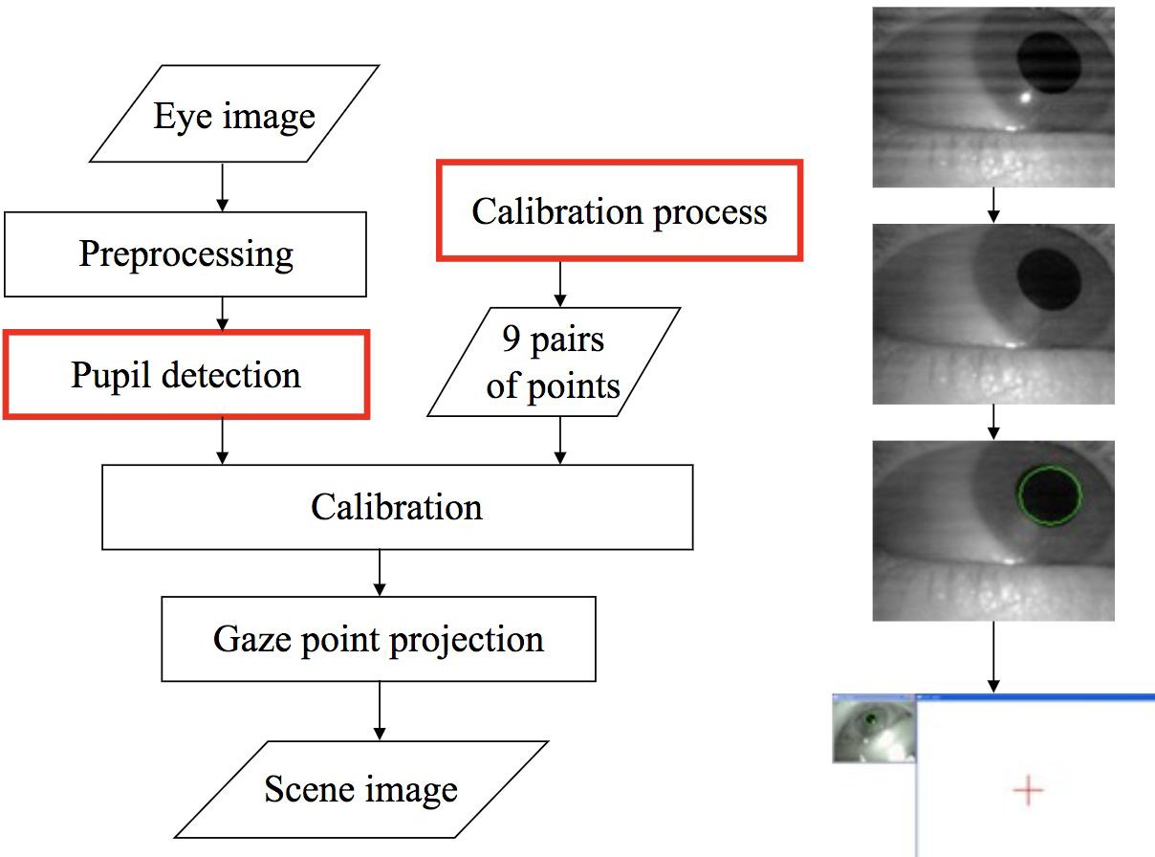

Slide 5
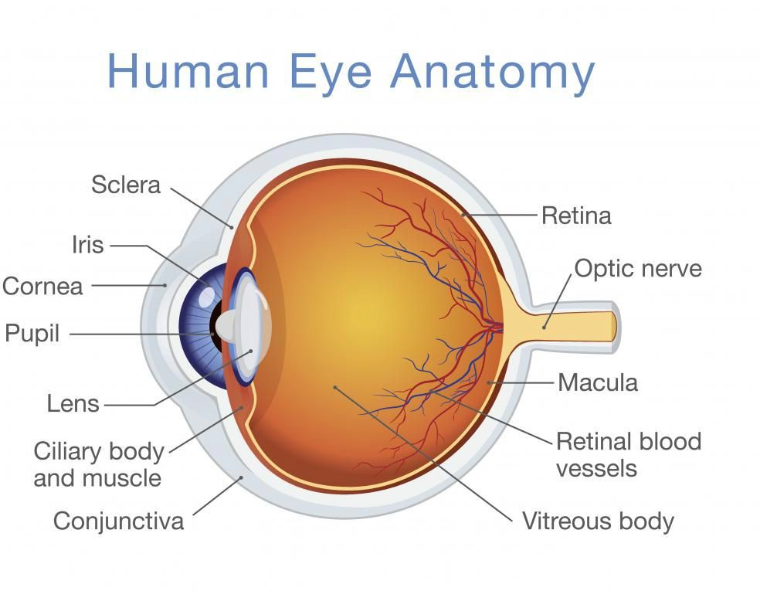
The Anatomy of the Eye
There are two light receptor cells in the retina: cone cells and
rod cells.
The visual field is a combination of the two primary types of vision:
  Foveal vision : create high resolution and colorful image, which is form by tightly packed cone cells which account for 6% of total retinal light receptors.
  Peripheral vision : create blurry and less colorful image, which is form by rod cells which account for the other 94% of total retinal light receptors.

Slide 6
Eye Tracking Devices
Surface electrodes, electrooculogram, Electro-oculography (EOG)
Scleral contact lens/search coil
Photo-Oculography (POG) or Video-Oculography (VOG)
Video-Based Combined pupil/corneal reflection

Slide 7
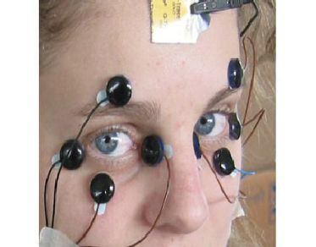
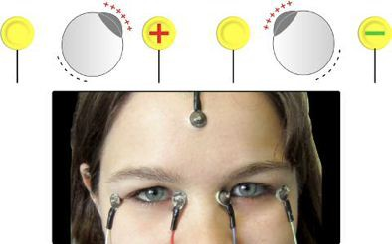
EOG
EOG method relies on measurement of skin’s potential differences, using electrodes placed around the eye
EOG techniques are helpful in measuring saccade latency, but not good at measuring location(unless head is also tracked)
Used more for diagnosis

Slide 8
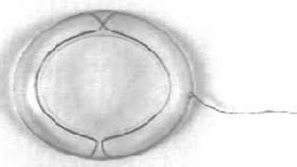
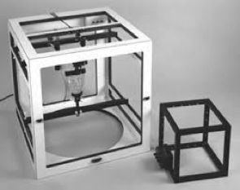
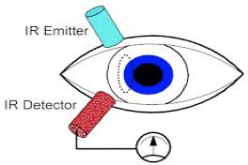
Scleral contact lens/search coil
Scleral coil embedded in contact lens and electromagnetic field frames
While scleral coils offer high spatial resolution (0.01°) and high temporal resolution (1,000 Hz), they are invasive and uncomfortable for participants, hence less preferred, except in clinical settings.

Slide 9
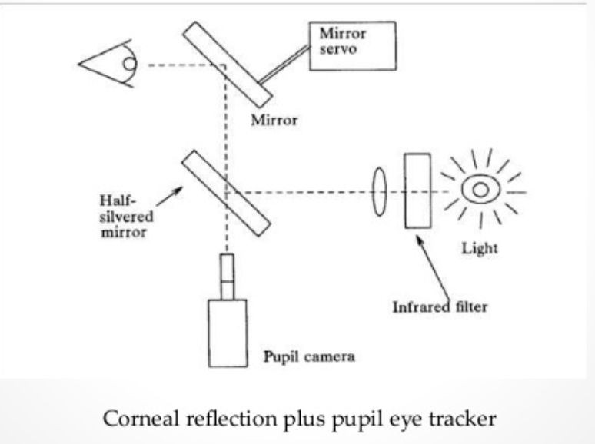
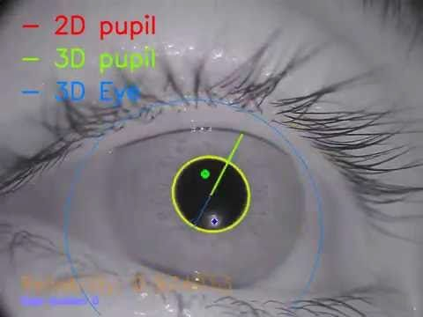
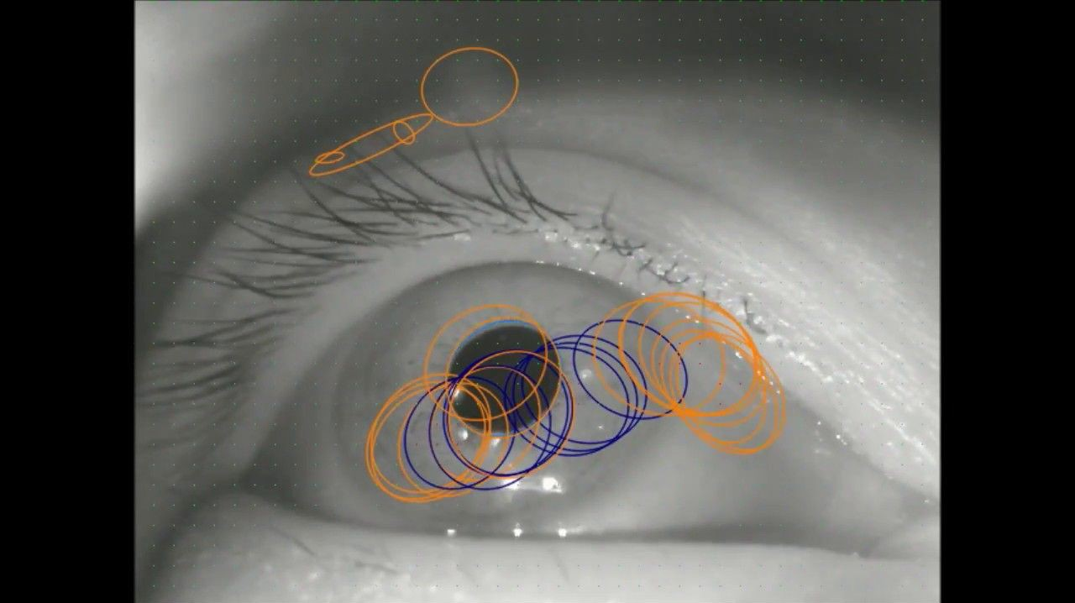
Video-Based Combined pupil/corneal reflection
Based on real-time image processing to recognize and localize pupil and corneal reflection
The “Red-Eye” effect when we take photo
Head mounted vs remote

Slide 10
Calibration
Eye tracker measures characteristics of the user’s eyes and uses them together with an internal, anatomical 3D eye model to calculate the gaze data.
The model includes information about shapes, light refraction and reflection properties of the different parts of the eyes (e.g. cornea, placement of the fovea, etc.)
During the calibration the user is asked to look at calibration dots. During this period several images of the eyes are collected and analyzed.

Slide 11
Ideal Eye Tracking Methods Should Have:
1. Accuracy
6. No prior calibration
2. Reliability
7. Real-time response
3. Robustness
8. Work for dynamic displays
4. Non-intrusiveness
9. Allow for study participants’ mobility
5. The possibility for free head movements
10. Be scalable

Slide 12
What is measured with Eye Tracking?

Slide 13
Types of Eye Movements
Our pupils are always moving
View static scene
  Saccades
  Fixation
View dynamic scene
  Vergence, Smooth pursuit, Drift, Rotation etc.
A strong hypothesis is the “eye-mind” hypothesis (Just & Carpenter, 1976), according to which it provides a “dynamic trace of where a person’s attention is being directed in relation to a visual scene.”
Eye fixations are known to be driven by perceptual salience and relevance as determined from prior experience to be important or informative (Loftus & Mackworth, 1978)

Slide 14
Saccades
Saccades are the type of eye movement used to move the fovea rapidly from one point of interest to another
Can be further categorized
Duration: 30 – 120 msec
Amplitude : 400 - 600°/sec
Latency : 100 – 30 msec
Refractory period : 100 – 300 msec

Slide 15
Fixation
Fixation is the period of time where the eye is kept aligned with the target for a certain duration, allowing for the image details to be processed.
Relatively stable eye-in-head position:
  Spatial dispersion : < 2°
  Minimal duration : 100 – 200 msec
  Threshold velocity : < 15 – 100° /msec

Slide 16
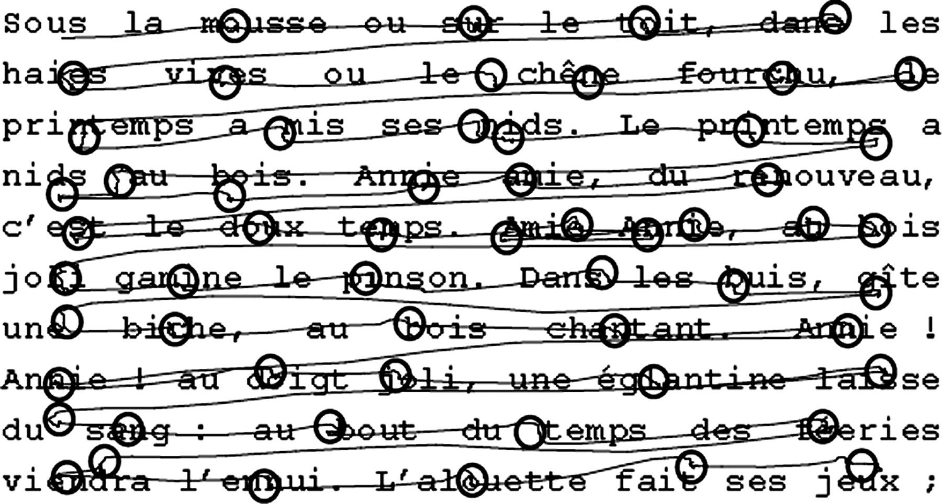
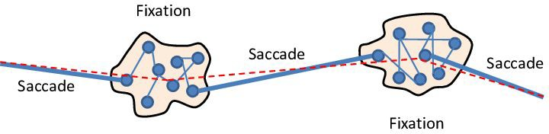
Scan path in Reading

Slide 17
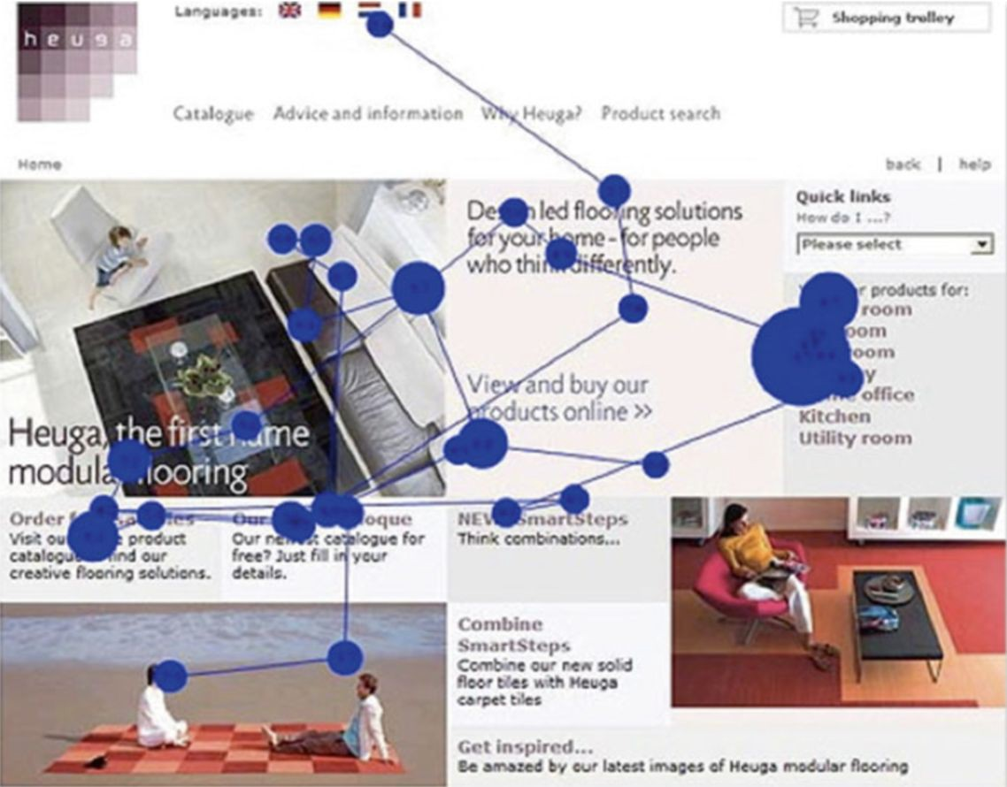
Interpret eye gaze data
Area Of Interest(AOI or ROI): Certain parts of a display or interface under evaluation, and analyzing the eye movements that fall within such areas
Fixation duration: How long do users notice as measured by dwell-time on a part of the visual scene
Number of fixations: How often do users notice a part of the visual scene
Sequence of fixations: The order in which users notice different parts of the visual scene
Transitions between pairs of areas of interest: How frequently users visit one area of interest from another

Slide 18
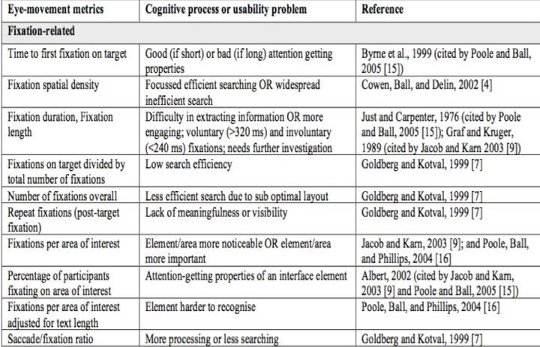

Slide 19
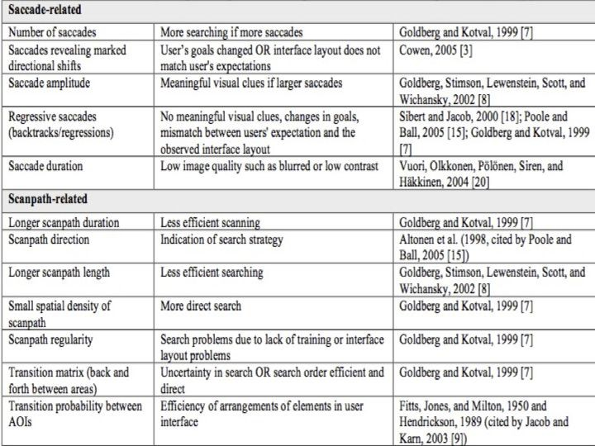

Slide 20
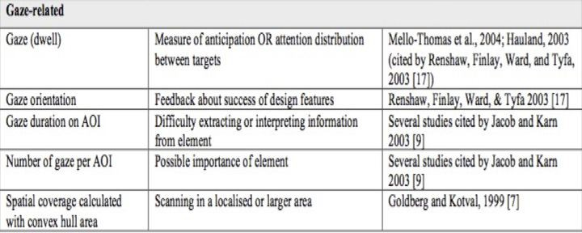

Slide 21
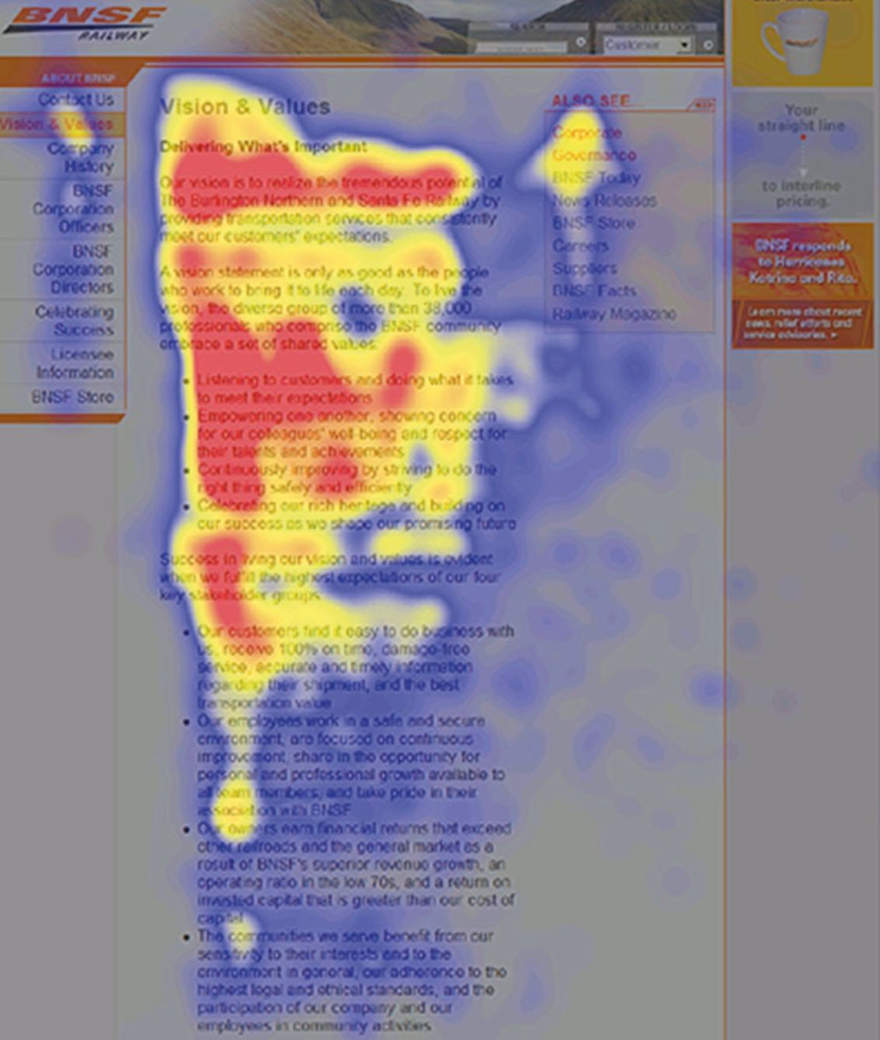
Gaze Plot (single user)
vs
Heat Map (aggregated)

Slide 22
Use of Eye Tracking in various fields
Vision Science (Neuroscience/Psychology): visual search, memory, scene perception
Computer Vision: Perceptual Models of Eye Gaze, predict eye gaze for images/videos
Psychology: Examination of cognitive process in Reading Behavior
Neuroscience: Detect medical conditions; Detect disorders
Market Research/usability Tests
HCI
  Understanding the perceptual aspects of user attention on displays
  Cognitive aspects of attention
  Social aspects of attention
  As an input method, using gaze as an alternative to the keyboard and mouse

Slide 23
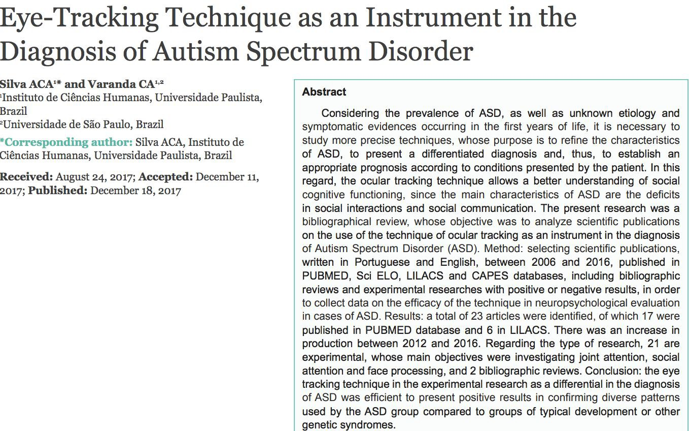


Slide 24

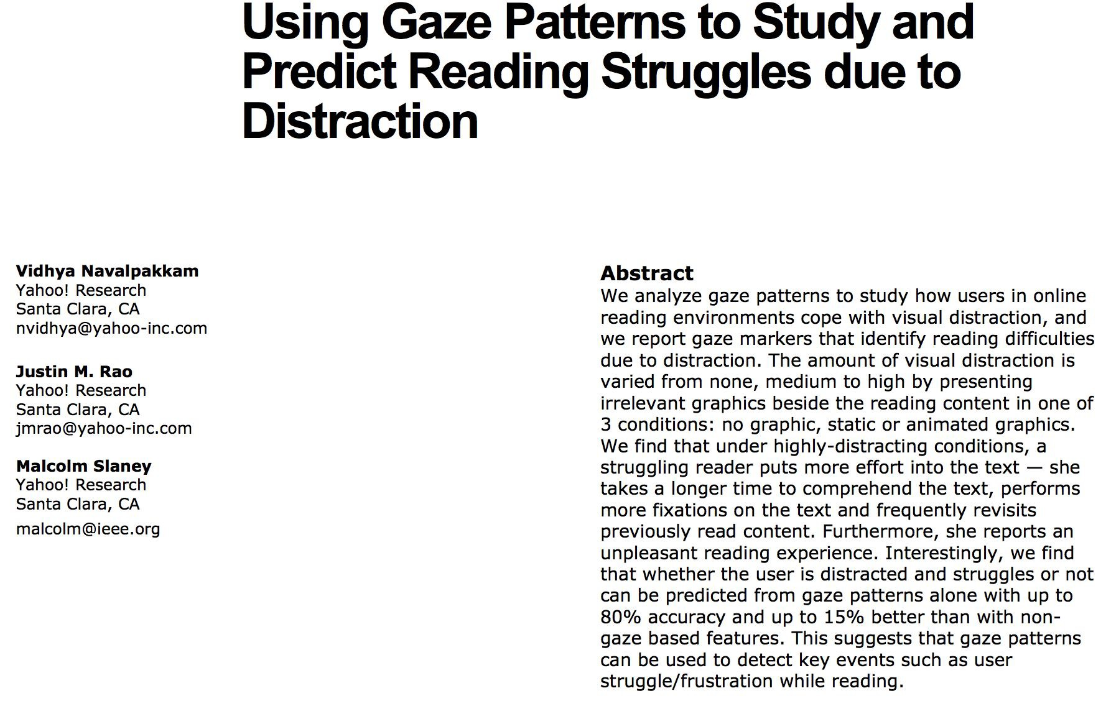

Slide 25
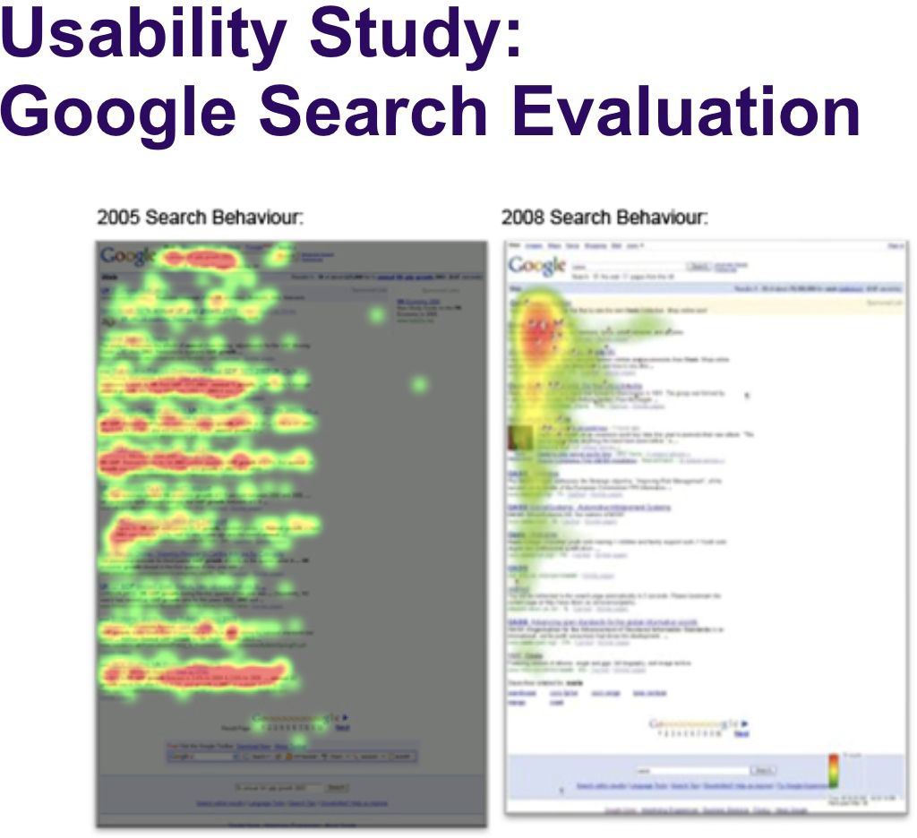
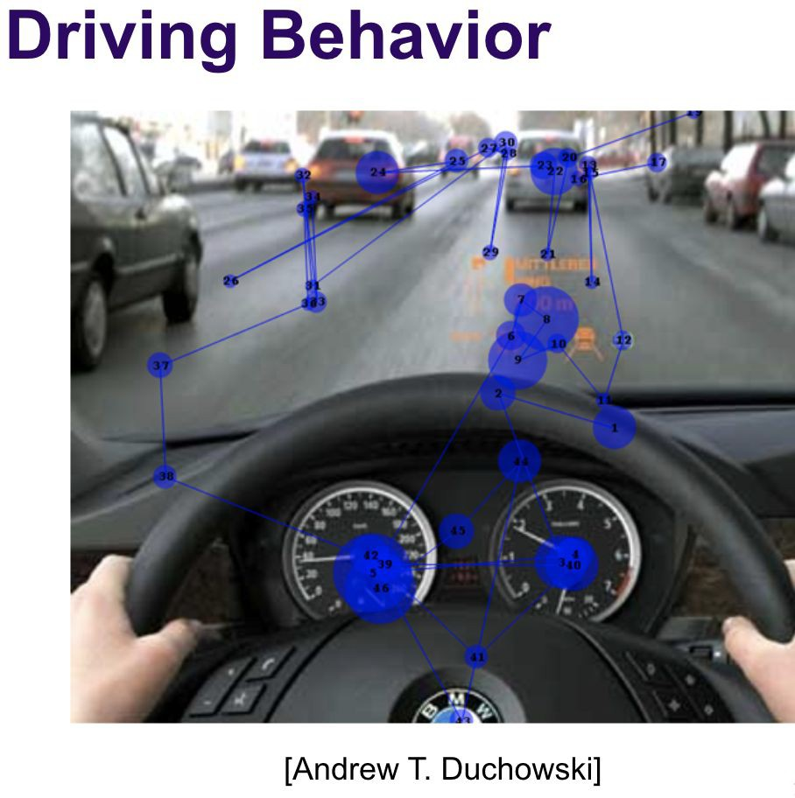

Slide 26
Benefits & Limitations
Benefits
  Eye movements are faster than other input methods
  No prior training or knowledge is required for normal people
  Can determine where the user’s interests are
Limitations
  Eye trackers are expensive
  Some people might have to be excluded
  Only one participant at the same time(slower than other research methods like Mturk surveys )

